Slide 1
Lists and Tuples

Slide 2
Introduction to Lists
Lists are ordered, mutable sequence of items . It allows us to manage collections of data .
Features:
Ordered
Mutable
Can store different data types for e.g : strings, integers, float, Boolean etc.
Lists use syntax “[ ]”

Slide 3
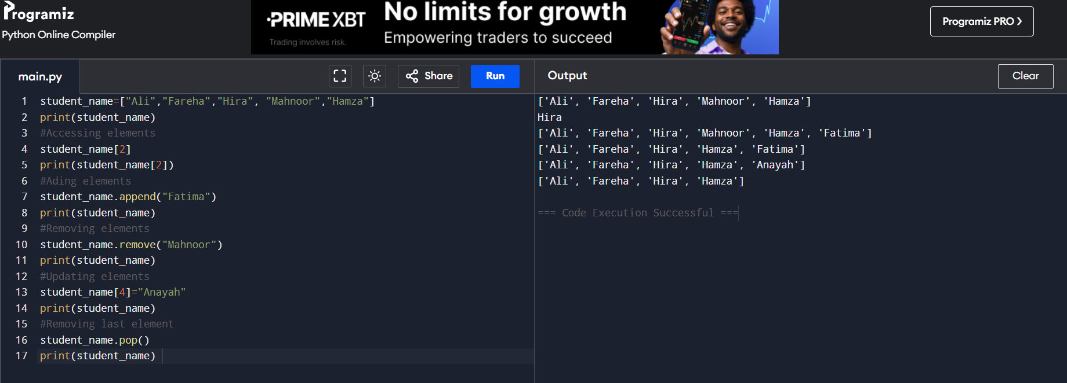
Common List operations
Accessing elements
Adding elements
Removing elements
Updating elements

Slide 4

Introduction to Tuples
A tuple is a finite sequence or ordered list of elements.
Features:
Immutable
Ordered
Allows duplicates
Tuples use syntax “( )”

Slide 5
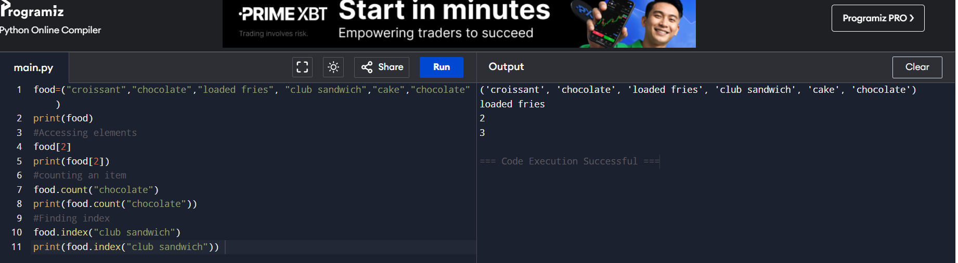
Common Tuples Operation
Access element
Count an item
Find index

Slide 6
Difference between Lists and Tuples
FEATURES | LIST | TUPLES
Syntax | [] | ()
Mutable | Yes | No
Performance | Slightly slower | Faster
Memory usage | More | Less
Ordered | Yes | Yes

Slide 7
Summary
Lists are mutable, making them ideal for data that changes.
Tuples are immutable, making them suitable for fixed data.
Both are ordered collections and support indexing and iteration.
Choosing between a list and a tuple depends on whether the data needs to be modified.

Slide 8
Thank you
Made By: Fareha Asfar

